Slide 1
Measurement of Glomerular Filtration Rate
using Quantitative SPECT/CT and
Deep-Learning based Kidney Segmentation

Slide 2
Abstract
Quantitative SPECT/CT : useful for accurate and reliable measurement of GFR
Manual drawing of VOI in CT images : labor-intensive & time consuming
Aim of this study : develop fully automated GFR quantification method based on deep-learning approach to the 3D segmentation of kidney parenchyma in CT
Proposed method
High Dice similarity coefficient (mean = 0.89)
Strongly correlated GFR (R2 = 0.96)
Absolute difference : 2.90%
Comparable performance in urolithiasis patients and kidney donors
Decrease individual GFR in symptomatic kidney vs normal
Fast and accurate GFR measurement

Slide 3
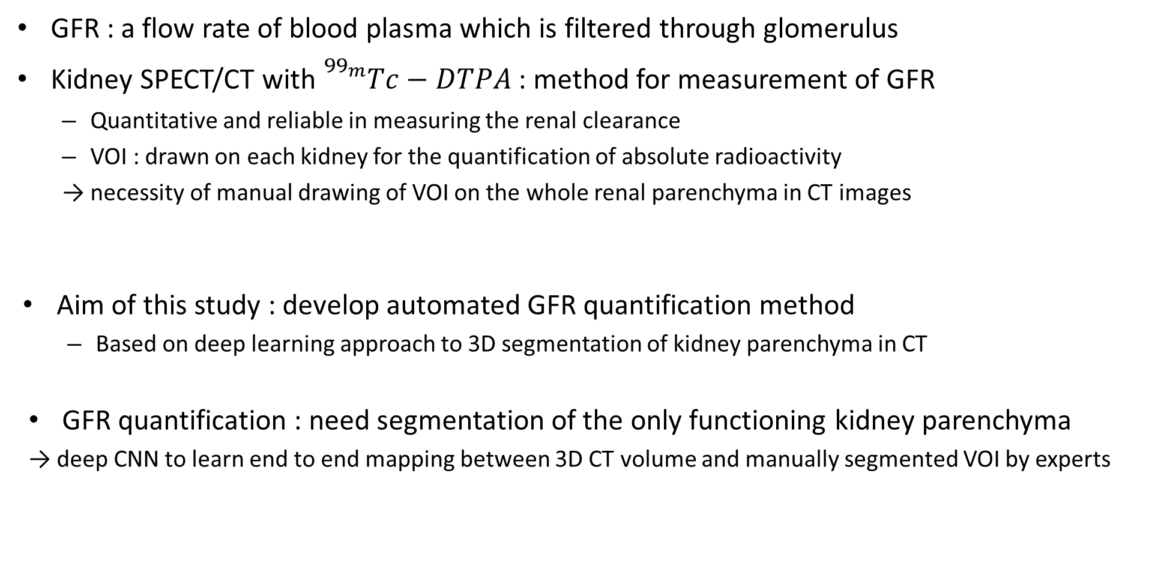
Introduction
GFR : a flow rate of blood plasma which is filtered through glomerulus
Kidney SPECT/CT with ${}_{}^{{99}_{m}}{Tc−DTPA}$ : method for measurement of GFR
Quantitative and reliable in measuring the renal clearance
VOI : drawn on each kidney for the quantification of absolute radioactivity
→ necessity of manual drawing of VOI on the whole renal parenchyma in CT images
Aim of this study : develop automated GFR quantification method
Based on deep learning approach to 3D segmentation of kidney parenchyma in CT
GFR quantification : need segmentation of the only functioning kidney parenchyma
→ deep CNN to learn end to end mapping between 3D CT volume and manually segmented VOI by experts
Labor intensive, time consuming(take 15 min per scan)

Slide 4
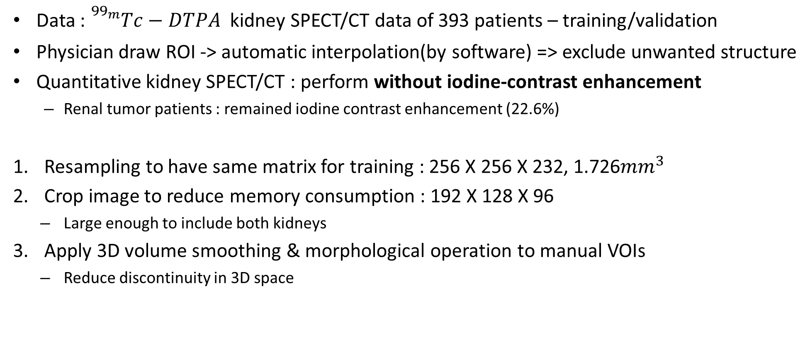
Method - dataset
Data : ${}_{}^{{99}_{m}}{Tc−DTPA}$ kidney SPECT/CT data of 393 patients – training/validation
Physician draw ROI -> automatic interpolation(by software) => exclude unwanted structure
Quantitative kidney SPECT/CT : perform without iodine-contrast enhancement
Renal tumor patients : remained iodine contrast enhancement (22.6%)
Resampling to have same matrix for training : 256 X 256 X 232, 1.726${mm}^{3}$
Crop image to reduce memory consumption : 192 X 128 X 96
Large enough to include both kidneys
Apply 3D volume smoothing & morphological operation to manual VOIs
Reduce discontinuity in 3D space

Slide 5
Method – Neural Network architecture
Use modified 3D U-net
End to end mapping between 3D - CT and manually drawn renal parenchyma VOIs
Contraction path : capture the context
5 sequential layers
3X3X3 conv → leaky ReLU → 2X2X2 strided conv → leaky ReLU → 3X3X3 conv → elementwise sum
Expansion path : enable precise localization
5 sequential layers
Upsampling : 1X1X1 conv → leaky ReLU → 2X2X2 deconv → leaky ReLU → 3X3X3 conv → leaky ReLU
Employ symmetric skip connection
Use 3D spatial drop-out(rate 0.3)
Adjacent voxels : correlated compared with batch normalization
Pre-activation residual block

Slide 6
Method – Neural Network architecture
Conv
3X3X3
same
s=1
Leaky
ReLU
Conv
2X2X2
same
s=2
Leaky
ReLU
Conv
3X3X3
same
s=1
Elementwise sum
96X64X16
96X64X16
96X64X16
192X128X32
192X128X32
Leaky
ReLU
Conv
2X2X2
same
s=2
Leaky
ReLU
Conv
3X3X3
same
s=1
Elementwise sum
48X32X8
48X32X8
48X32X8
Leaky
ReLU
Conv
2X2X2
same
s=2
Leaky
ReLU
Conv
3X3X3
same
s=1
Elementwise sum
24X16X4
24X16X4
24X16X4
Leaky
ReLU
Conv
2X2X2
same
s=2
Leaky
ReLU
Conv
3X3X3
same
s=1
Elementwise sum
12X8X2
12X8X2
12X8X2

Slide 7
Method – Neural Network architecture
Conv
3X3X3
same
s=1
Leaky
ReLU
deconv
2X2X2
Leaky
ReLU
Conv
3X3X3
same
s=1
Leaky
ReLU
Conv
1X1X1
same
s=1
Leaky
ReLU
12X8X2
12X8X2
24X16X4
24X16X4
24X16X4
Skip connection
deconv
2X2X2
Leaky
ReLU
Conv
3X3X3
same
s=1
Leaky
ReLU
Conv
1X1X1
same
s=1
Leaky
ReLU
Skip connection
48X32X8
48X32X8
48X32X8
deconv
2X2X2
Leaky
ReLU
Conv
3X3X3
same
s=1
Leaky
ReLU
deconv
2X2X2
Leaky
ReLU
Skip connection
96X64X16
96X64X16
Skip connection
192X128X32
Conv
3X3X3
same
s=1
Leaky
ReLU
Conv
1X1X1
same
s=1
Leaky
ReLU
Elementwise sum
192X128X32
192X128X32
192X128X32

Slide 8
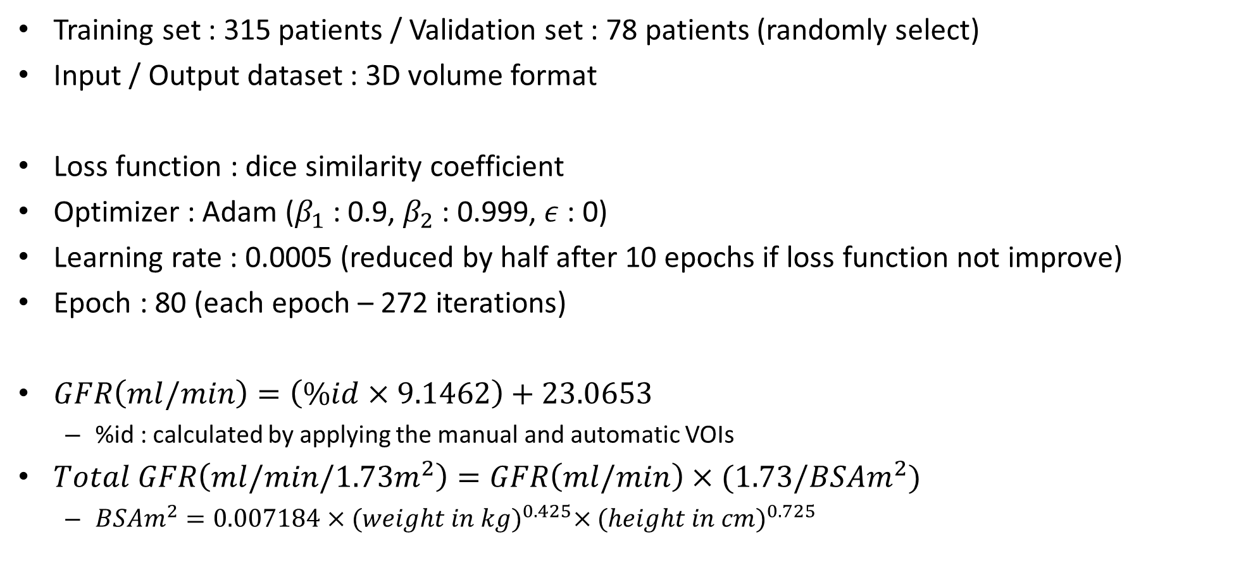
Method – Network Training/GFR estimation
Training set : 315 patients / Validation set : 78 patients (randomly select)
Input / Output dataset : 3D volume format
Loss function : dice similarity coefficient
Optimizer : Adam ($β_{1}$ : 0.9, $β_{2}$ : 0.999, $ε$ : 0)
Learning rate : 0.0005 (reduced by half after 10 epochs if loss function not improve)
Epoch : 80 (each epoch – 272 iterations)
$GFR\left(ml/min\right)=\left(\%id×9.1462\right)+23.0653$
%id : calculated by applying the manual and automatic VOIs
$Total GFR\left(ml/min/1.73m^{2}\right)=GFR\left(ml/min\right)×(1.73/BSAm^{2})$
$BSAm^{2}=0.007184×{(weight in kg)}^{0.425}×{(height in cm)}^{0.725}$

Slide 9
Method – Further Validation
Patients with urinary stones & kidney donors as negative controls
126 kidneys from 63 urinary stone patients (age higher than normal group)
50 kidneys from 25 kidney donors
50 normal kidneys (from kidney donor patients)
48 symptomatic kidneys (either ureter stone of any size or large renal stone/longest diameter>10mm)
78 asymptomatic kidneys (either small renal stone or contralateral kidney
GFR value for manual segmentation
Average of two independent measurement of GFR by four medical experts
GFR value for automatic segmentation
Single measurement of GFR

Slide 10
Method – Data Analysis
Evaluation : calculate Dice similarity coefficient
Assess correlation, mean absolute percentage error
Perform 5 – fold cross-validation
Statistical analysis in urolithiasis patients
Evaluate normality of data : use D’Agnostino-Pearson test
Parametric : independent samples t-test / one-way analysis of variance
Nonparametric : Mann-Whitney test / Wilcoxon test / Kruskal-Wallis test
Chi-square test : analysis of categorical data
Multiple comparison correction for t-test : Bonferroni correction
Results with P-values less than 0.05

Slide 11
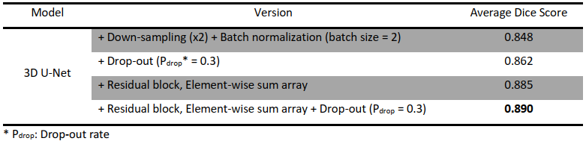
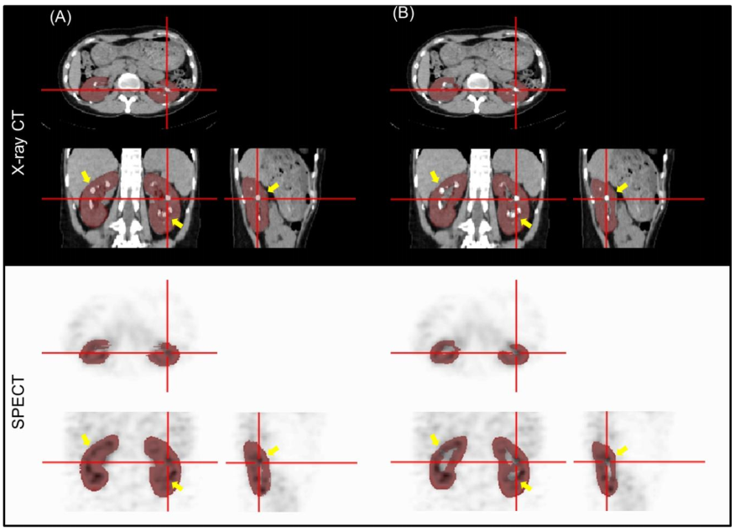
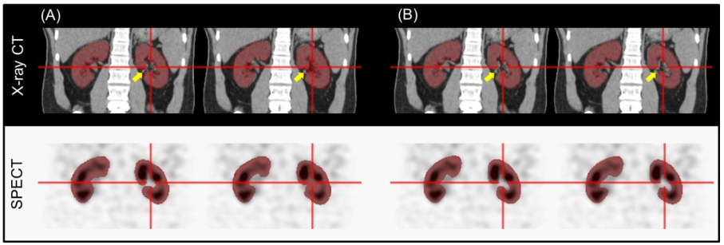

Results – Segmentation
High Dice similarity coefficient : mean $±$ SD = 0.89 $±$ 0.03
3D kidney parenchyma VOIs : no discontinuity between slices (CNN trained to produce smooth 3D VOIs)
Time requirement : a few seconds per patient
Manual segmentation : 15 min per scan
Ablation study
Result
manual
segmentation

Slide 12
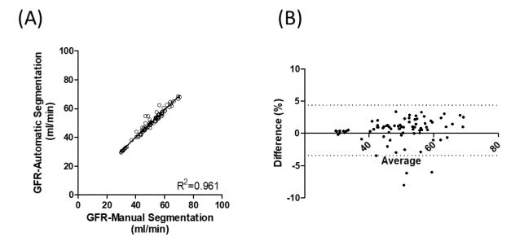
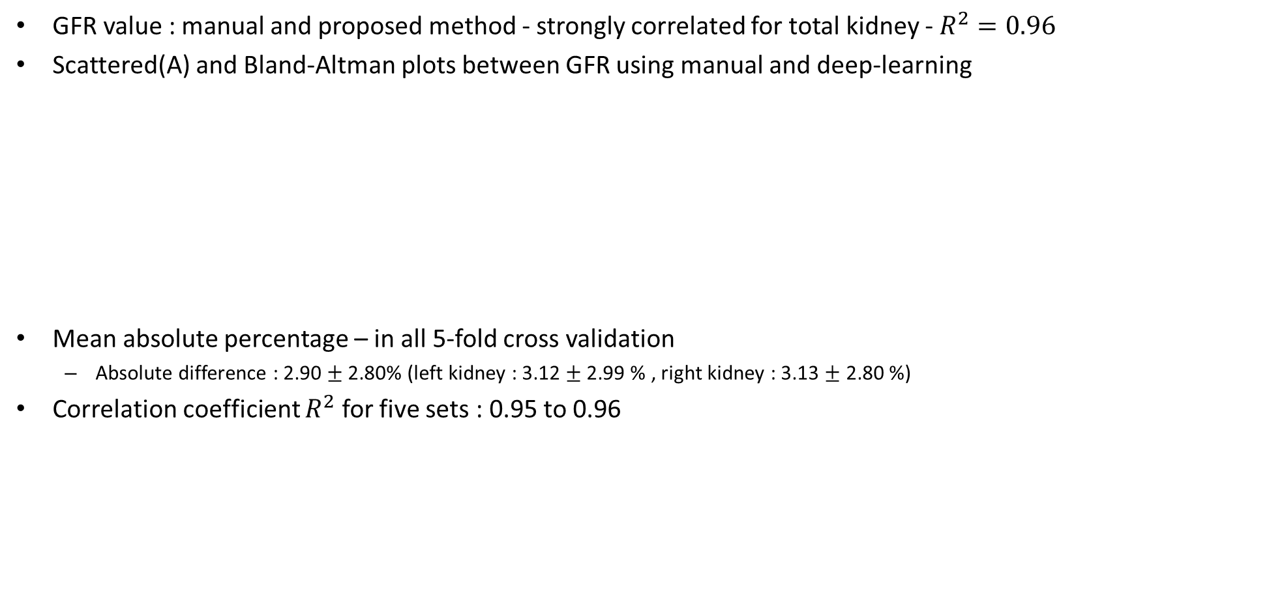
Results – GFR Estimation
GFR value : manual and proposed method - strongly correlated for total kidney - $R^{2}=0.96$
Scattered(A) and Bland-Altman plots between GFR using manual and deep-learning
Mean absolute percentage – in all 5-fold cross validation
Absolute difference : 2.90 $±$ 2.80% (left kidney : 3.12 $±$ 2.99 % , right kidney : 3.13 $±$ 2.80 %)
Correlation coefficient $R^{2}$ for five sets : 0.95 to 0.96

Slide 13
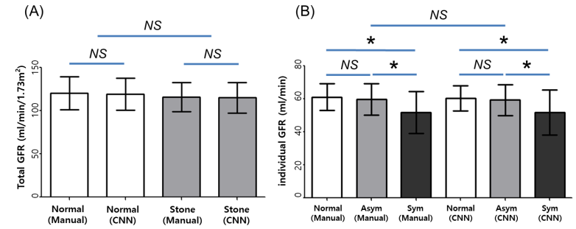
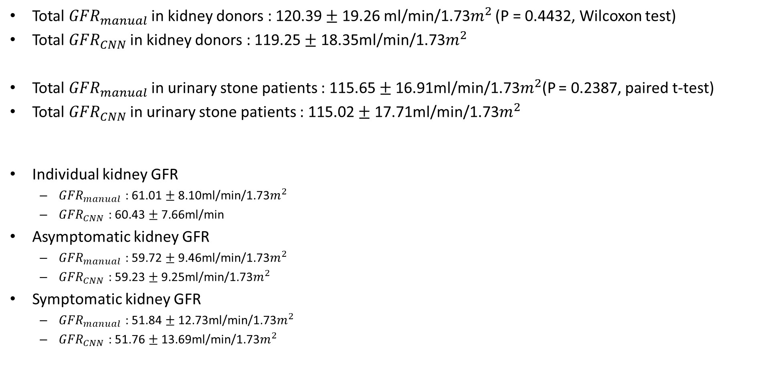
Results – Validation
Total ${GFR}_{manual}$ in kidney donors : 120.39 $±$ 19.26 ml/min/1.73$m^{2}$ (P = 0.4432, Wilcoxon test)
Total ${GFR}_{CNN}$ in kidney donors : 119.25 $±$ 18.35ml/min/1.73$m^{2}$
Total ${GFR}_{manual}$ in urinary stone patients : 115.65 $±$16.91ml/min/1.73$m^{2}$(P = 0.2387, paired t-test)
Total ${GFR}_{CNN}$ in urinary stone patients : 115.02 $±$ 17.71ml/min/1.73$m^{2}$
Individual kidney GFR
${GFR}_{manual}$ : 61.01 $±$ 8.10ml/min/1.73$m^{2}$
${GFR}_{CNN}$ : 60.43 $±$ 7.66ml/min
Asymptomatic kidney GFR
${GFR}_{manual}$ : 59.72 $±$ 9.46ml/min/1.73$m^{2}$
${GFR}_{CNN}$ : 59.23 $±$ 9.25ml/min/1.73$m^{2}$
Symptomatic kidney GFR
${GFR}_{manual}$ : 51.84 $±$ 12.73ml/min/1.73$m^{2}$
${GFR}_{CNN}$ : 51.76 $±$ 13.69ml/min/1.73$m^{2}$

Slide 14
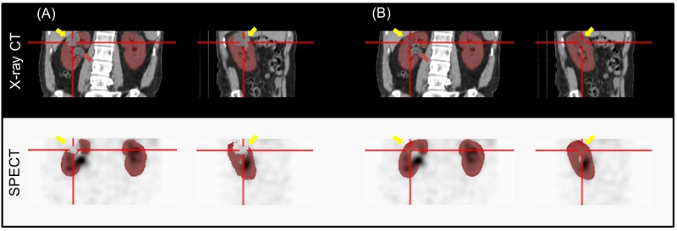
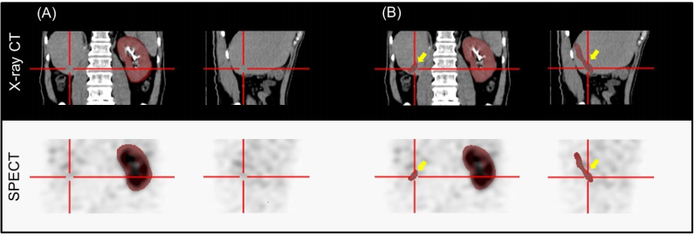
Discussion
Deep learning approach
highly accurate in renal parenchyma segmentation in CT
useful for automated measurement of GFR
Automatically drawing VOIs only on renal parenchyma excluding cysts : several cases were not accurate
Incorrectly included, renal pelvis well excluded
2. Only a single kidney
Smaller than others → insufficient data
GFR error low (radio activity in tumor very low)
3 single kidney case among training set
Additional dataset necessary

Slide 15
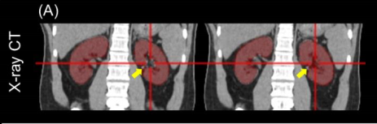
Discussion
3. Segmentation error in manual VOIs
Further clinical validation
Use in more complicated cases such as multi-cystic dysplastic kidneys
Discontinuity in the perpendicular direction to the ROIs
Subsequent inter-slice ROI-interpolation

